Slide 1
Harnessing the Gut Microbiome
Separating the Hype from the Evidence
Lee Jones
CEO, Rebiotix
Sept 2015

Slide 2
Pioneer in Microbiota Restoration Therapy
Privately held clinical stage company
Founded in 2011 to treat debilitating diseases by harnessing the power of the human gut microbiome
Developing new class of biologic drugs based on live human-derived microbes
First company to take this new class of drugs through the FDA

Slide 4
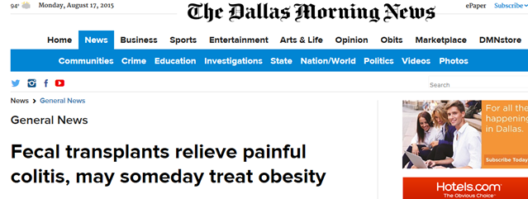
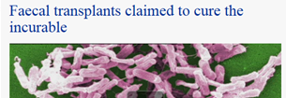
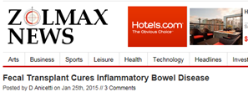
Good Hype: Fecal Transplant Cures All

Slide 5
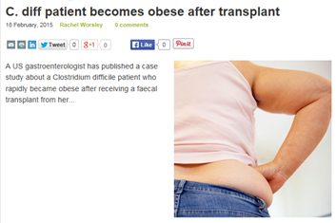
Bad Hype: FT Causes Obesity
Weight Gain After Fecal Transplantation*
Pre FMT
Recipient weight: 133 lbs.
Donor weight: 140 lbs.
Post FMT (16 mos./36 mos.)
Recipient weight: 170 lbs./177 lbs.
Donor weight: 170 lbs.
If both the recipient and the donor gained weight, does that mean being a donor makes you gain weight ????????
*Brief Report, OFID, 1 Alang et al
Notes:
Point of article was missed - data on possible adverse events is limited and it is something to watch out for.

Slide 6
What is Reality?
Lots of promise – good and bad
Mostly anecdotal efficacy data
Overall lack of rigorous safety data
Both short and long term

Slide 7
Hype Creates False Hope
Notes:
Bone Marrow Transplant for Breast CA
The human microbiome has generated a lot of excitement around it potential to treat disease. However, man medical therapies that seem exciting at first ultimately fail to deliver on their on their initial promise. Bone marrow transplant for breast cancer is one example.
30,000 women in US received bone marrow transplants for breast CA between 1985 and 1998 at the cost of millions of dollars, considerable adverse effects and treatment-related mortality rates of 3-15%
False Hope is the story of high-dose chemotherapy and stem-cell rescue
Many factors fueled the enthusiastic adoption of this unproven strategy, including the often unrealistic but desperate hopes of patients and the economic and academic rewards that could be reaped by participating doctors and hospitals. Perhaps most important, the authors of False Hope describe in great detail the political and social pressures that led many leaders in the field of oncology to ignore the time-proven scientific process that has supported applications of toxic therapies in so many other instances in the field.
Hormone Replacement
Published April 2012: US Preventative Services Task Force confirms that estrogen and progestin replacement therapy should be used sparingly, only to ward off the most intense symptoms of menopause, and not to protect against chronic disease.
Before 2002, doctors recommended that women use supplemental hormone treatment to restore levels of estrogen and progestin, which naturally wane during menopause.
Optimal Medical Therapy with or without Percutaneous Coronary Intervention
Although treatment guidelines recommended an initial approach of intensive medical therapy, reduction of risk factors, and lifestyle modification for patients with stable coronary artery disease, percutaneous coronary intervention (PCI) was still a common initial treatment strategy for patients with stable coronary artery disease at the time this study was performed.
The authors found that PCI added to optimal medical therapy did not reduce the risk of death, myocardial infarction, or other major cardiovascular events
Decade of Reversal
Physicians sought to identify medical practices that offer no net benefits
Reviewed all original articles published in 10 years (2001-2010) in one high-impact journal between August 1, 2011, through October 31, 201
Conclusion: The reversal of established medical practice is common and occurs across all classes of medical practice.
Tie into Rebiotix – this is exactly why we at Rebiotix have taken the strategy we have, to ensure that we have substantial medical evidence to support the use of our product

Slide 8
Commercial Perspective
What we believed:
MRT had great promise
Fecal transplants seemed to work for recurrent Clostridium difficile infection (rCDI)
A logistics problem
Adoption slow due to manufacturing process
FDA approval a must for wide access and safety
Targeted Product to Be:
Easy to use
Patient friendly
Fit into current medical practice
Safe and effective

Slide 9
Market Entry: Clostridium difficile
Debilitating infectious gastrointestinal disease
>29,000 US deaths annually*
Low risk bet in the microbiome space
Fecal transplant - historically proven treatment
Unmet medical need
There is no currently approved treatment for patients with 2 or more recurrences
Growing population*
*Burden of Clostridium difficile Infection in the United States, NEJM 2015:372:825-34
Notes:
Need references

Slide 10
Commercialization Strategy: rCDI
Strategy: Comprehensive clinical trial plan to produce medical based scientific evidence (no hype)
Product Objective: Standardized, quality controlled, FDA approved product
Lead Product: RBX2660
Full spectrum microbial composition
Cryopreserved
Enhanced donor screening
Simple off-the-shelf enema delivery system
No anesthesia or bowel prep*
*Currently only product under IND investigation in US without bowel prep

Slide 11
Clinical Trial Strategy: Recurrent C diff
PUNCH™ CD
Multi-center, open-label; min 30 pts followed for 6 months
Secondary Objective: Efficacy, no CDI recurrence at 8 wks.
PUNCH™ CD 2
Multi-center, randomized, double-blind, placebo controlled; 120 pts followed for 24 months
PUNCH™ CD 3
Confirmatory Trial
Multi-center, prospective efficacy and safety study
Randomized, controlled
Secondary Objective: Safety of RBX2660
Primary Objective: Assess the safety of RBX2660
Enrollment completed Nov 2013
Primary Objective: Efficacy of RBX2660
Enrollment completed Sept. 2015
Supportive for BLA application

Slide 12
2012 Beliefs: The Good, The Bad, and The Ugly
Nearly 100% cure with one treatment
Wouldn’t work if diarrhea wasn’t controlled by antibiotics before transplant
Need colonoscopy bowel prep regardless of method of delivery
Donor key to patient success
If failure with one donor; second treatment needed different donor
Best donors were related to the patient
100% safe - no adverse events

Slide 13
PUNCH™ CD: Study Design
Safety – primary concern of FDA
Restricted inclusion criteria parameters
at least two recurrences of CDI after a primary episode
and have completed at least two rounds of standard-of-care oral antibiotic therapy
OR
have had at least two episodes of severe CDI resulting in hospitalization prior to enrollment

Slide 14
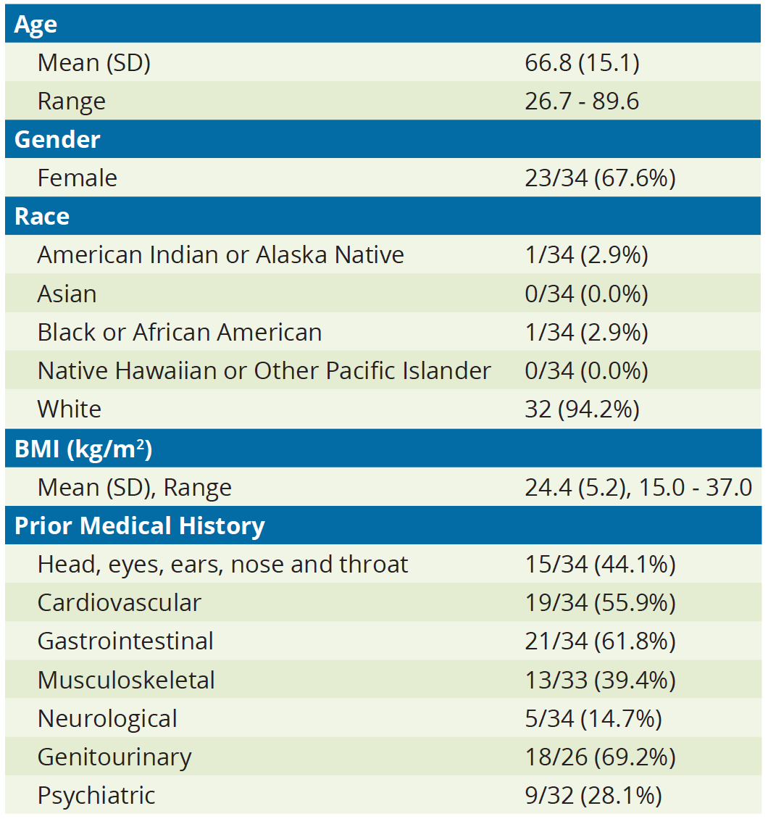
PUNCH™ CD: Baseline Characteristics
Failed antibiotics
Metronidazole, Vancomycin, Fidaxomicin; including Vancomycin and Fidaxomicin tapers
Patients were at high risk for recurrence and generally very ill at enrollment
Patients typically had one or more comorbidities

Slide 15
PUNCH™ CD Open Label Safety Trial*
*not an intent to treat study

Slide 16
PUNCH™ CD: Safety Assessment Methods
AEs solicited during 6-month follow-up after each dose of RBX2660
First 7 days: study diary documenting 11 pre-specified types of AEs
Patients asked about AEs during all encounters:
Office visits: 7,30 and 60 days
Calls: weekly through 8 weeks; at 3 and 6 months
Investigator and study medical monitor evaluated AEs for:
Seriousness
Severity
Causality/relatedness to:
RBX2660
Enema procedure
CDI
Pre-existing condition

Slide 17
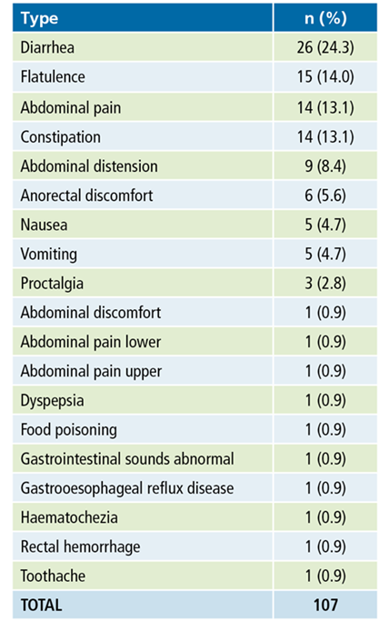
PUNCH™ CD: AEs
GI disorders were most commonly reported
Of the most common GI AEs - diarrhea, flatulence, abdominal pain, and constipation – all cases were self-limiting
Notes:
Need references

Slide 18
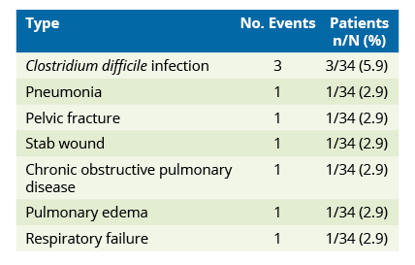
PUNCH™ CD: SAEs
Serious Adverse Events Through 60-Day Follow-up
All events were adjudicated by an independent medical monitor and were determined to be unrelated to the product or the procedure
Notes:
Need references

Slide 19
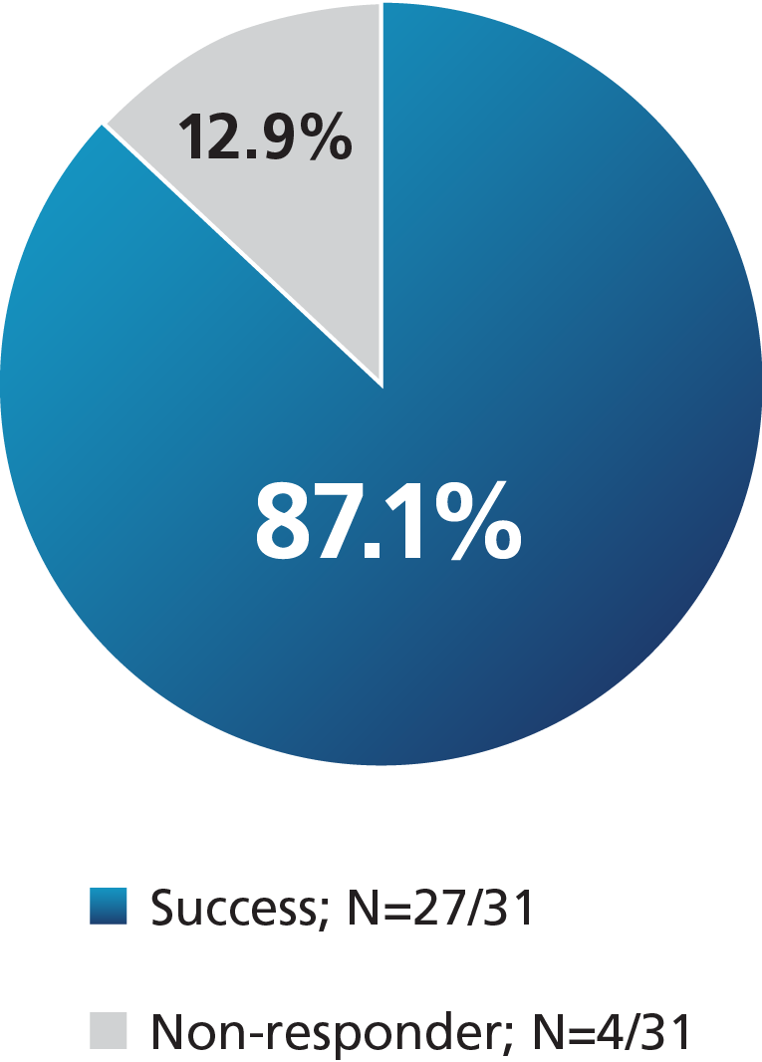
PUNCH™ CD: Efficacy
87.1% represents absence of CDI at 8 weeks
No additional occurrences in successful patients out to 6 months with/without antibiotic treatment for other indications

Slide 20
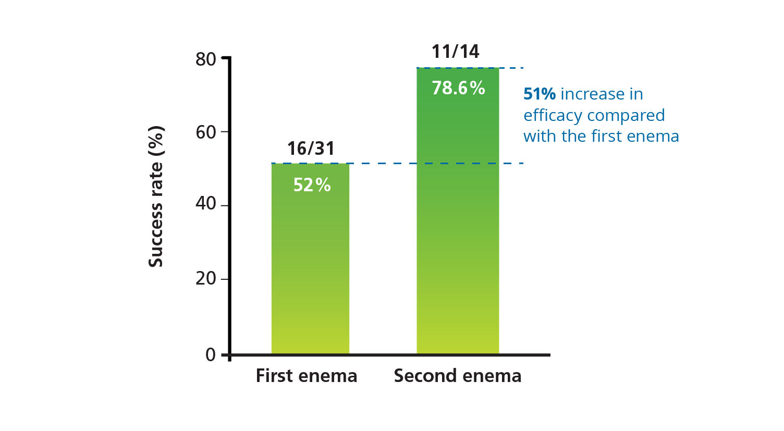
PUNCH™ CD: Efficacy
First enema of RBX2660 was administered after a 10-14 day course of antibiotics
Second enema of RBX2660 was administered without antibiotic pre-treatment

Slide 21
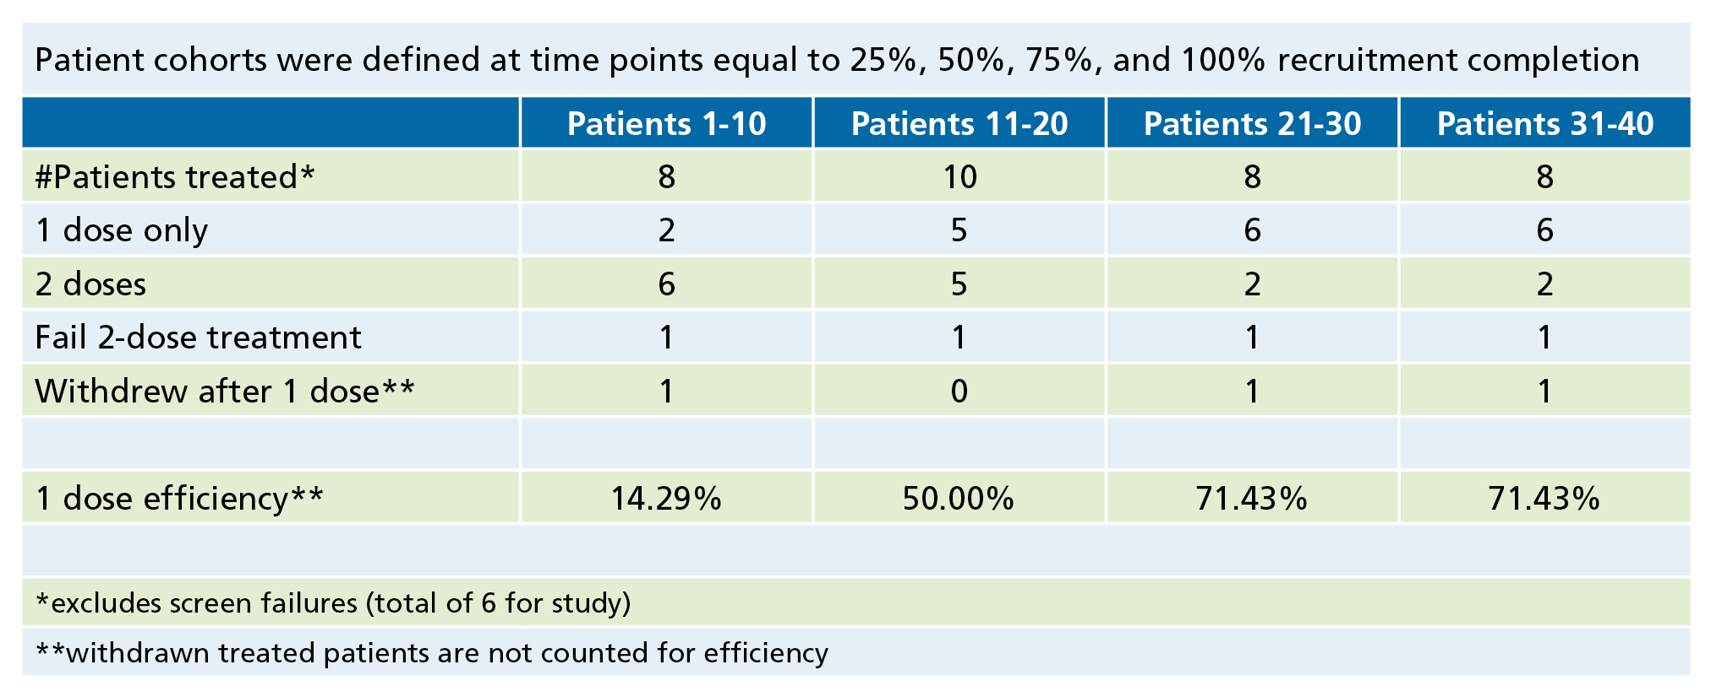
PUNCH™ CD: Observations
Patients had long standing disease and multiple co-morbidities
There were nuances to their treatment
One dose only efficacy appeared to increase as sites gained experience with MRT for RCDI
Notes:
Need references

Slide 22
Does the Donor Effect Patient Outcome?
Methods
Patients who required 2 doses could receive RBX2660 manufactured from the same or different donors.
Same pair of donors could also be used in a different order.
NO!
Success was not impacted by the donor or dose order
Results
34 patients (mean age 68.8 years, 67.6% female) received at least 1 dose of RBX2660.
19 patients received 1 dose and 15 patients received 2 doses.
Notes:
The relative importance of the donor was assessed in the PUNCH CD study.
Success was not impacted by the donor or dose order.
Based on an analysis of small numbers, it appears that the specific donor does not affect the outcomes achieved with administration of RBX2260 for recurrent CDI.
The results suggest that outcomes are patient-specific and it is not necessary to switch donors in order to achieve a cure if the first dose fails.
Additional research with a larger patient cohort along with in-depth comparative analysis of donor and patient microbiota is needed to provide more details on patient-specific factors impacting success or failure with this therapy.

Slide 23
Additional Proof-of Concept
Secondary analysis of Vancomycin Resistant Enterococcus (VRE) clearance in infected patients
8/10 patients testing positive for VRE became negative
Additional study needed to further assess the relationship between VRE and CDI clearance
Notes:
Need references

Slide 24
PUNCH™ CD: Conclusions
Rigorous, independent assessment of AEs
Overall satisfactory safety profile
No serious AEs attributed to RBX2660 or its administration
GI-related AEs common within 7 days of first dose
Declined over time
Less common with second dose
Overall efficacy 87.1%
Efficacy of second dose with no antibiotic pretreatment higher than first dose with antibiotic pretreatment

Slide 25
2012 Beliefs: The Good, The Bad, and The Ugly
Nearly 100% cure with one treatment
Wouldn’t work if diarrhea wasn’t controlled by antibiotics before transplant
Need colonoscopy bowel prep regardless of method of delivery
Donor key to patient success
If failure with one donor; second treatment needed different donor
Best donors were related to the patient
100% safe - no adverse events

Slide 26
2015 Evidence: The Good, No Bad, No Ugly
Cure rate was high - but not 100% with one dose
Some patients needed more than one treatment; time related “healing” or regeneration of the microbiome was evaluated by longitudinal 16s rRNA gene sequencing
Product worked in patients with active diarrhea
Bowel prep of any kind was not needed
Donor did not affect outcome
Non-related universal donors worked
Cure was durable
No additional occurrences in successful patients out to 6 months with/without antibiotic treatment for other indications
Clearance of other MDRO organisms promising future indication

Slide 27
PUNCH™ CD 2: Groundbreaking MRT Trial
First ever multicenter, randomized, double-blind, placebo controlled IND study for microbiota based drug
Multicenter, prospective efficacy and safety study
Randomized
Double blind
Placebo controlled
120 patients
Three treatment arms
21 sites in US and Canada
Enrollment completed Sept 2015

Slide 28
PUNCH™ CD 3 Confirmatory Trial
Multicenter, prospective efficacy and safety study
Randomized
Controlled
Two treatment arms
Up to 40 US and Canadian sites

Slide 29
RBX2660 Regulatory Milestones
Fast Track status granted
Orphan Drug designation granted
Phase 2 clinical enrollment completed
Health Canada clinical ‘No Objections’ letter
Breakthrough application submitted
Sep 2015
Aug 2015
Dec 2014
Phase 2B enrollment completed
Mar 2014
Nov 2013
May 2013

Slide 30
Human Gut Microbiome: Expanding Clinical Frontier
2011
2015
Infectious
Disease
Fecal transplant for recurrent Clostridium difficile (rCDI)
Metabolic
Disease
Neuro
Gut Microbiota
Liver Disease
Inflammatory
Disease
Notes:
Value of C. Diff. opportunity: $1.1B Market for 1st and multi-recurrent C diff
Industry has expanded from one indication to over 21 potential indications in five different areas of medicine
Value of top eight 2015 Opportunities is >$100B

Slide 31
Expanding the MRT Universe
Room temperature stable oral formula in development
Partnering with researchers to:
Investigate new indications
Investigate new formulations

Slide 32
Harnessing the Power of the Gut Microbiome
Pioneering new microbiota based drugs to solve urgent unmet medical needs
“Dehyping” the “hype” by conducting clinical trials that generate medical-based scientific evidence
Providing wide access to potentially life saving drugs through FDA approval process
Changing the therapeutic landscape

Slide 33
Thank you
Additional information, contact: Lee Jones
Ljones@Rebiotix.com
651-705-8772

